Slide 1
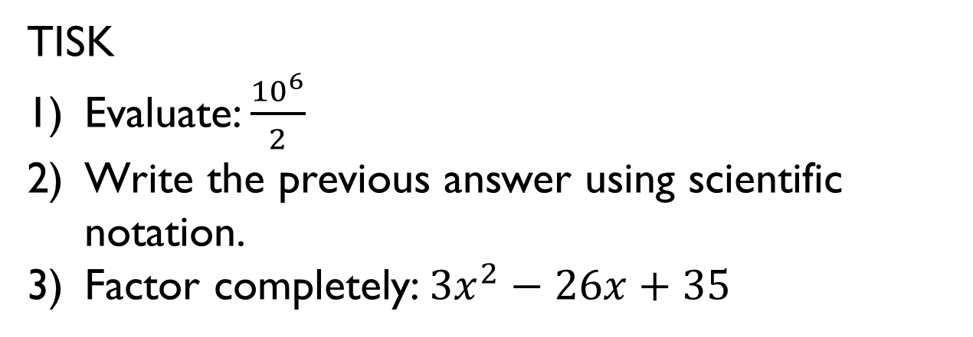
Thursday, January 17, 2013
Agenda:
TISK & 2 MM
Receive Graded Work
Lesson 7-5 part 1
Homework: Begin 7-5 problems in HW Packet
TISK
Evaluate: $\frac{{10}^{6}}{2}$
Write the previous answer using scientific notation.
Factor completely: $3x^{2}−26x+35$
Notes:
Mental Math
1.) Start with 4 more than the product of 8 and 7. (60) Add the number of degrees in a right angle. (150) Divide by the number of minutes in a quarter of an hour. (10) Subtract the largest single-digit perfect square. (1)
2.) Start with 7 more than the product of 5 and 9. (52) Add the number of degrees in an angle complementary to 32 degrees. (110) Divide by the number of sides in a decagon. (11) Subtract the smallest two-digit perfect square. (-5) Add the number of days in a week. (2)

Slide 2
Graded Work
Chapter 7 Quiz 1
9A
82% class average; 95.85% class median
100% highest grade
25% lowest grade
9B
87.1% class average; 92.5% class median
100% highest grade
53% lowest grade
Check for missing work online!

Slide 3
§7-5 Parts of Similar Triangles
Proportional Perimeters Theorem
If two triangles are similar, then the perimeters are proportional to the measures of corresponding sides.
D
A
E
F
$$\frac{AC}{DF}=\frac{BC}{EF}=\frac{AB}{DE}$$
$$\frac{AB+BC+AC}{DE+EF+DF}=$$
B
C
$$ΔABC\sim ΔDEF$$

Slide 4
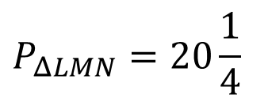
§7-5 Parts of Similar Triangles
Example
If $ΔLMN\sim ΔQRS, QR=40, RS=41, SQ=9,$and $LM=9,$find the perimeter of $ΔLMN.$
Draw and label a picture!
Use the Proportional Perimeters Theorem to set up a proportion!
R
M
40
41
9
L
N
Q
9
S
40
$$\frac{90}{LM+LN+MN}=\frac{40}{9}$$
$$\frac{SQ+QR+SR}{LM+LN+MN}=$$
9
40
41
$$\frac{QR}{LM}$$
9
$$40\left(P_{ΔLMN}\right)=810$$
$$P_{ΔLMN}=\frac{810}{40}$$
$$P_{ΔLMN}=20\frac{1}{4}$$

Slide 5


§7-5 Parts of Similar Triangles
Theorem
If two triangles are similar, then the measures of the corresponding altitudes are proportional to the measures of the corresponding sides.
D
A
$$\frac{AX}{DY}=$$
$$\frac{AC}{DF}=\frac{BC}{EF}=\frac{AB}{DE}$$
E
F
Y
B
C
X
$$ΔABC\sim ΔDEF$$

Slide 6
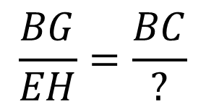
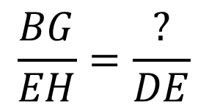
§7-5 Parts of Similar Triangles
Example
In the figure, $ΔABC\sim ΔDEF.$If $\overline{BG}$is an altitude of $ΔABC$, and $\overline{EH}$is an altitude of $ΔDEF$, then complete the following.
$$AB$$
$$\frac{BG}{EH}=\frac{BC}{?}$$
$$\frac{BG}{EH}=\frac{?}{DE}$$
$$EF$$

Slide 7
Friday, January 18, 2013
Agenda:
No TISK, No MM
Finish Lesson 7-5
Time to work on Homework (?)
Homework: Finish 7-5 problems in Ch7 HW Packet 2

Slide 8
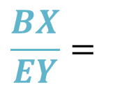
§7-5 Parts of Similar Triangles
Theorem
If two triangles are similar, then the measures of the corresponding angle bisectors are proportional to the measures of the corresponding sides.
D
A
Y
$$\frac{BX}{EY}=$$
$$\frac{AC}{DF}=\frac{BC}{EF}=\frac{AB}{DE}$$
X
E
F
B
C
$$ΔABC\sim ΔDEF$$

Slide 9
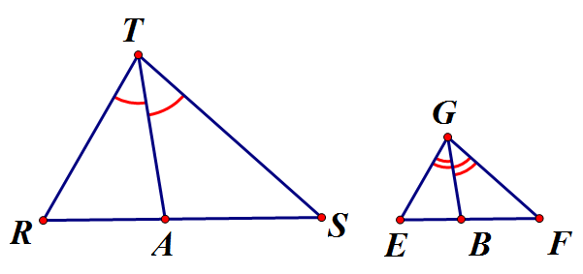
§7-5 Parts of Similar Triangles
Proof of the theorem.
Given: $ΔRTS\sim ΔEGF$ $\overline{TA}$ is an angle bisector of $∠RTS$ $\overline{GB}$ is an angle bisector of $∠EGF$
Prove: $\frac{TA}{GB}=\frac{RT}{EG}$
Statement | Reason
1. $ΔRTS\sim ΔEGF$
1. Given
2. $∠RTS≅∠EGF$
2. 2 $Δ$s are ~ $⇔$ corr. $∠$s are $≅$ and corr. sides are proportional (Def. ~ $Δ$s)
$$∠R≅∠E$$
3. $\overline{TA}$ is an angle bisector of $∠RTS$ $\overline{GB}$ is an angle bisector of $∠EGF$
3. Given
4. $∠RTA≅∠ATS;∠EGB≅∠BGF$
4. Def. angle bisectors
5. $m∠RTA=m∠ATS;m∠EGB=m∠BGF$ $$m∠RTS=m∠EGF$$
5. Def. $≅∠$s
6. $m∠RTA+m∠ATS=m∠RTS;$ $$m∠EGB+m∠BGF=m∠EGF;$$
6. $∠$ Add. Post.
Continued on board

Slide 10
§7-5 Parts of Similar Triangles
Theorem
If two triangles are similar, then the measures of the corresponding medians are proportional to the measures of the corresponding sides.
D
A
$$\frac{AX}{DY}=$$
$$\frac{AC}{DF}=\frac{BC}{EF}=\frac{AB}{DE}$$
E
F
Y
B
C
X
$$ΔABC\sim ΔDEF$$

Slide 11
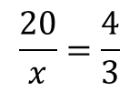
§7-5 Parts of Similar Triangles
Example
Find the value of x.
Since the triangles are similar (AA ~ Post.) we know that the medians are proportional to the sides.
Therefore, $\frac{20}{x}=\frac{16}{12}$
20
x
16
12
$$\frac{20}{x}=\frac{4}{3}$$
$$4x=60$$
$$x=15$$

